Slide 1
TEAM MEDICINE
COVID19 UPDATES
MARCH 27 2020

Slide 2
COVID19 current state 3.27.20
511 Tested
17 COVID positive inpatient (3 DAV5/6)
55 inpatient PUI
Employee/Providers: 7
121 pending results
LABS: State, Mayo Clinic Lab, Broad institutes
Coming soon in house testing (1-2weeks)
TAT: 48hrs or less

Slide 3
Supply chain
Masks / Face-shields:
  N95 – added supply
  Surgical Masks/Face shields/Eyewear – available
  Gown – available, low
  Reusable googles – available
  Disinfectant wipes - low
Testing kits:
  739 COVID kits
  NP v. OP swabs

Slide 4
CSM & SW STAFFING CHANGE
SOCIAL WORK
WED 25th: SW staff will be working primarily remotely with one SW on site
CASE MANAGEMENT
THURS 26th: One CSM per floor (similar to weekend model), other CSM remote M-F. We can communicate needs to onsite CSM who communicate with their team.
MDR
Changes to MDR: MDs will be called to round with RNs one MD at a time. With anticipated 15min per MD.
FEEDBACK?

Slide 5
Case Reviews

Slide 6
CASE I
A pleasant 63yo female with history of morbid obesity, asthma now presenting with worsening dry cough and wheezing for 3 days.

Slide 7
63yo female with a history of morbid obesity, asthma, diabetes, hypertension, mild pulmonary hypertension, GERD, obstructive sleep apnea, chronic pain who presents with wheezing since last 3 days, dry cough.
Denies any travel experience. Denies any new cats. She has a cat since last 6 years. No new pattern of also. She denies any exacerbating factors like a cold. She denies any recent Covid-19 contact. Denies fever.
She lives at home with her husband. Denies any other complaints. She has never smoked.
Given cough and shortness of breath and patient requiring admission, COVID19 test was sent per ED.
This episode is similar to her prior asthma exacerbation episodes. She denies ever being intubated.

Slide 8
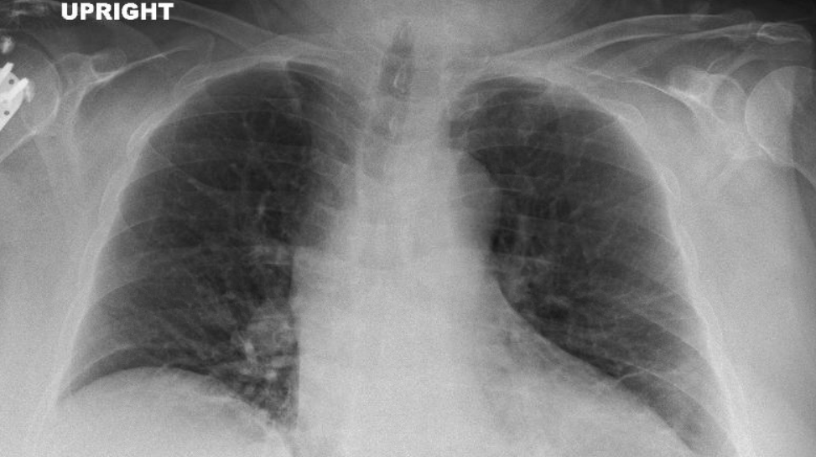

Slide 9
ADMISSION:
Presenting with asthma exacerbation. Denies travel history. She is also being ruled out for Covid 19. Treated with Solu-Medrol in ED and inhalers. No history of prior intubations for asthma exacerbation. BMI 63.
Acute exacerbation asthma exacerbation. Unclear etiology. This is similar to her previous asthma exacerbation per patient. We will continue the patient on Solu-Medrol and inhalers for now.
Avoid nebulizers as possible given risk of aerosolizing possible concurrent COVID19 - Although less likely. A Covid 19 test sent from ED and pending. She will be maintained on Droplet and contact isolation precautions for now. (OSA – nighttime CPAP continued)
HOSPITAL DAY 2
Bilateral wheezing, T-max 99.3, SBP up to 200, denies headache blurry vision. DOE, able to talk in full sentences. On 2 L oxygen.
HOSPITAL DAY 3
Shortness breath, still has bilateral wheezing. Afebrile. T-max 99.1. Blood pressure uncontrolled. SBP 150-190. On 2 L oxygen. Transient Restless at night.

Slide 10
Aches and pains in both legs x 2 days.
No known COVID19 exposure but visits relatives who have been out and about including Foxwoods. Several family members have been tested for COVID19 but have not received results.
Still wheezing.
Still short of breath.
Not much relief with the mdis.
Uses CPAP a lot at home.
Has some leg pains.
Exacerbation of asthma
She has a long history of asthma and her symptoms currently are consistent with an asthma exacerbation. The trigger is unclear currently. Her testing for influenza, RSV, pneumococcus and Legionella are nondiagnostic. Her COVID-19 is pending. She notes some leg pains which are concerning for myalgias.
She does not feel any better since coming in the hospital. We need to await the COVID19 test result. Because she has ongoing wheezing and dyspnea I think stepping up her therapy to Solu-Medrol 80 mg IV every 8 hours can be helpful for the asthma. She currently is receiving MDIs rather than nebulizers because of potential aerosolization with the nebulizer.
Can continue Singulair, Advair 500 twice daily.
Agree with empiric coverage with doxycycline.

Slide 11
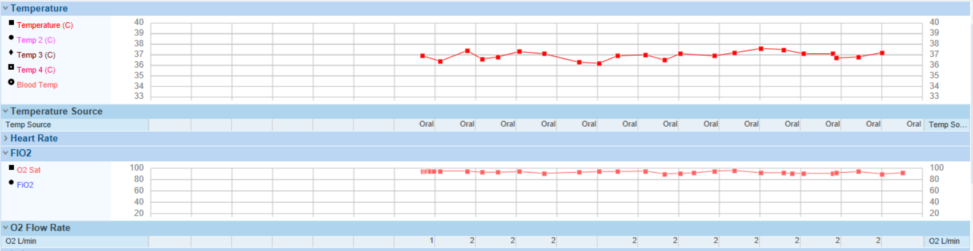

Slide 12
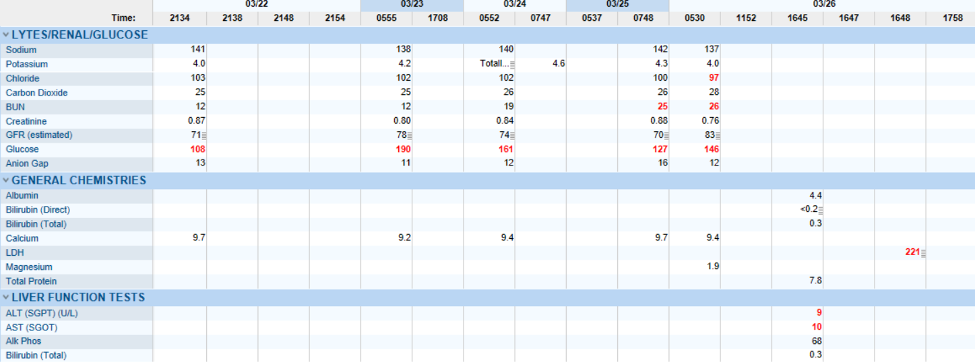
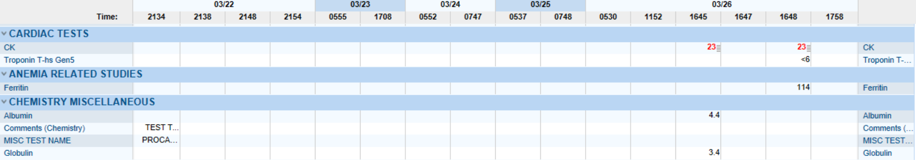

Slide 13
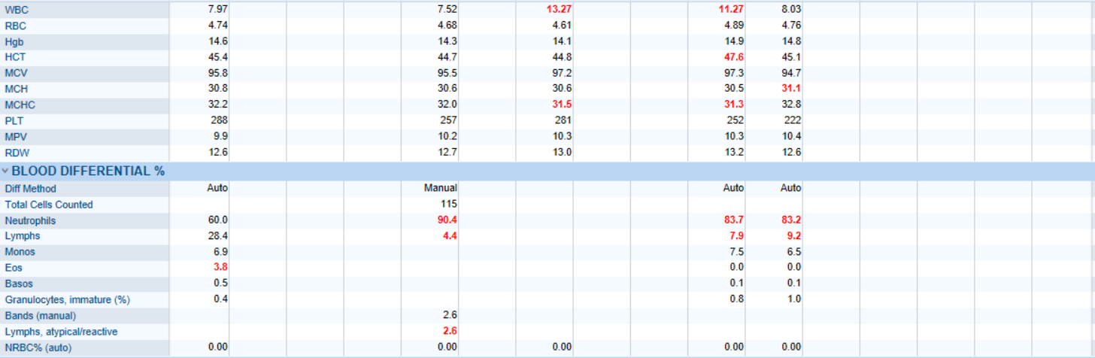
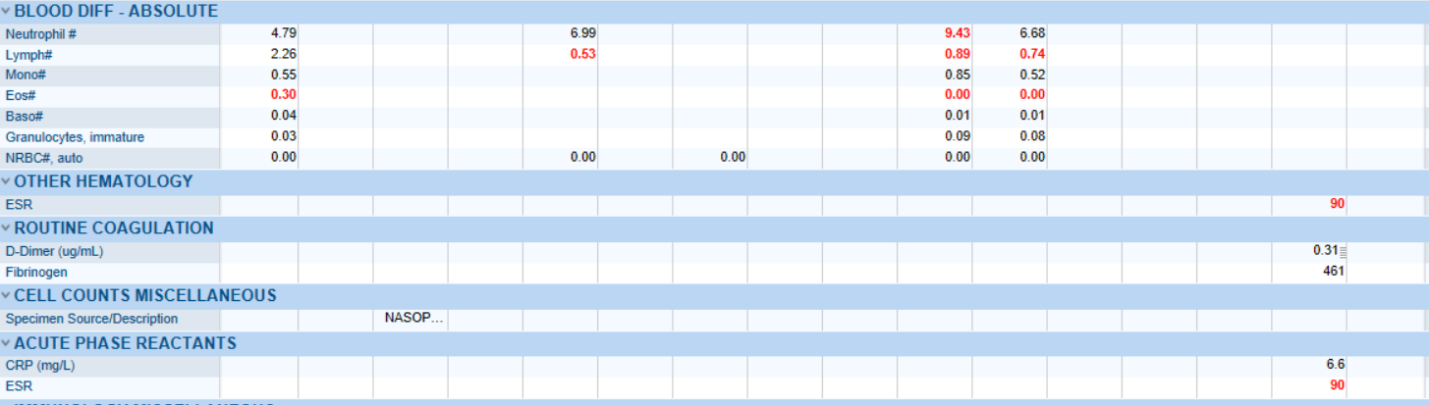

Slide 14
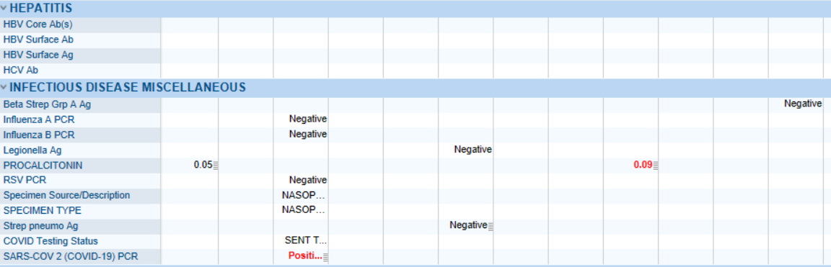
COVID19!

Slide 15
PEARLS
Patient Story: Pertinent positives/negatives
Clinical Course: Dyspnea, O2 needs, Fever/chills, Myalgias
Daily labs: Lymphopenia
Avoid: Aerosolizing procedures (including nighttime CPAP), steroids

Slide 16
CASE II
65 y/o presented with headache, nausea, then diarrhea & loss of smell followed by cough and hypoxia.

Slide 17
65yo female with PMH of HTN, NIDDM2, GERD, lumbar radiculopathy, overactive bladder came to ED with complaint of dizziness, dehydration not feeling well.
As per patient about 4 days ago she started feeling fatigued, tired, lethargic, she felt she was feeling dehydrated and having some dizziness and lightheadedness. She denied any associated fever, chills, diaphoresis, cough, SOB, chest pain, palpitation, headache, blurry vision, nausea, vomiting, diarrhea, constipation, abdominal pain or urinary symptoms. She states she had decreased appetite and has some low back pain.
She works as a home health aide in Boston areas and she worked until last Monday (03/16/2019). She lives alone in an apartment building, she denies any recent travel, denies any other family member had traveled or had exposure. She stopped taking omeprazole on Saturday because it was causing diarrhea. And the diarrhea was stopped. She also stopped taking oxybutynin because it was making her mouth dry.. She is ex-smoker quit about 20 years ago used to smoke 1 pack a day for about 10 to 15 years. Denies alcohol or any other recreational drug use. She denies taking any NSAIDs or any other pain medication.
Vitals upon arrival to ED: BP–169/127, HR–97, RR–24, SPO2–94% on room air, T–97.2 °F

Slide 18
Symptoms: Stable. She reports shortness of breath, malaise, cough, weakness, anorexia, diarrhea and anxiety. No chest pain, headache or chest pressure.
Diet: Poor intake. No vomiting.
Activity level: Impaired due to weakness.
Pain: She reports no pain.
Additional comments: Feels very washed out. No blood in stool or cramping. Occasional cough with minimal sputum.
admitted 3/18/2020 with dizziness, dehydration, malaise, lethargy.
Flu/RSV was negative
She denied resp complaints initially but CT chest was abnl
She has since had sob and DOE, hypoxia on oxygen 2L
She c/o cough with deep inspiration
She is being tested for COVID as well
Since admission 3 of 4 BLCX have returned positive for GPC CL
She has been febrile 100.2
She works for partners home care so she sees a lot of people but hasnt been working this past week due to feeling malaised
She denies abd pain
She was having diarrhea at home, but here it is much worse, she says it is muddy appearing
She denies cramping
She denies urinary symptoms
She denies vomiting

Slide 19
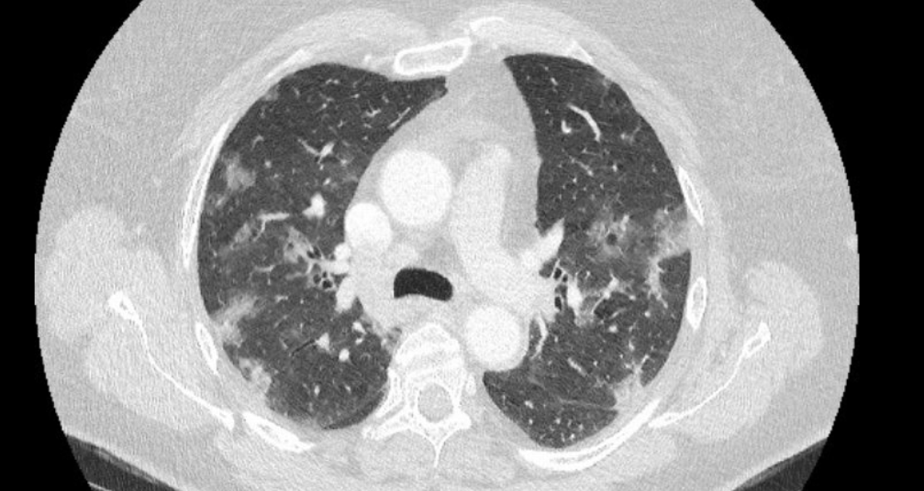
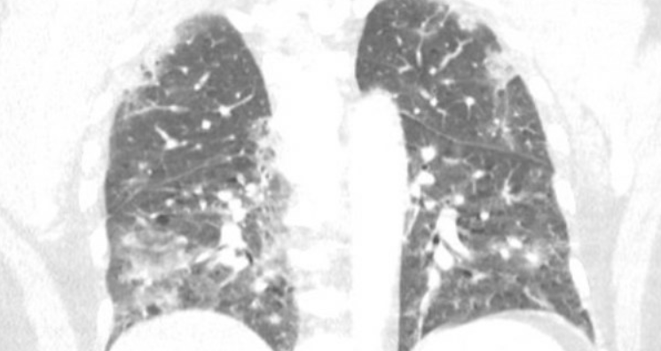
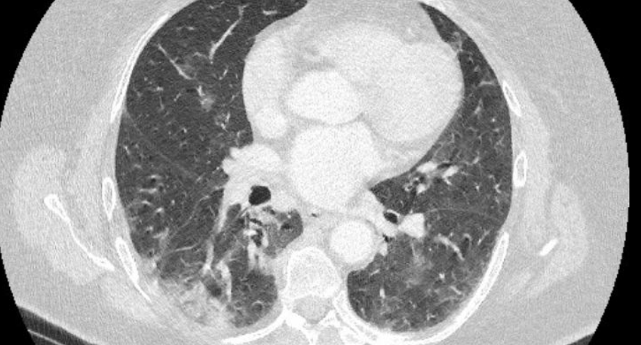
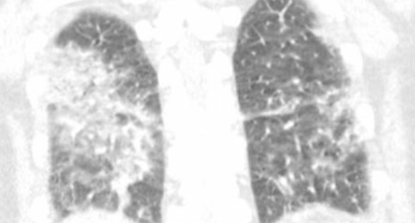

Slide 20
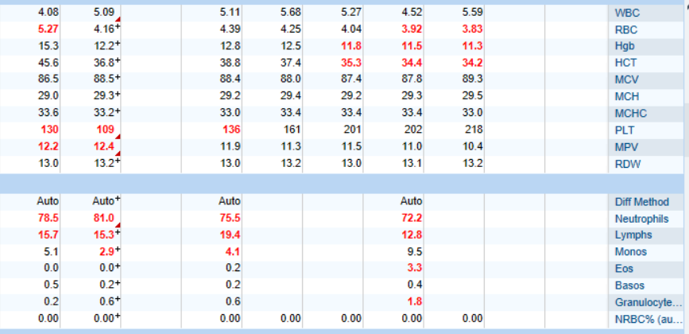
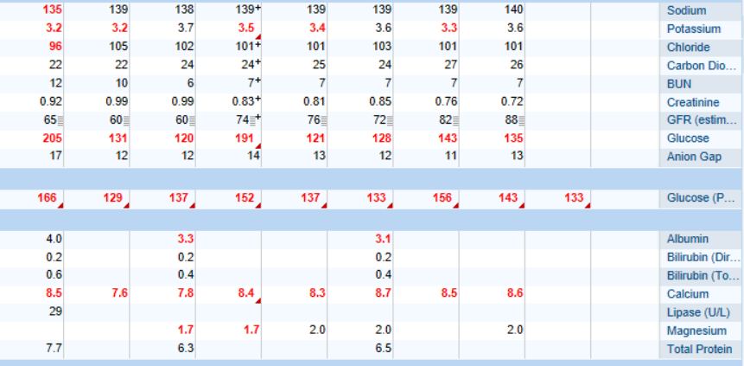
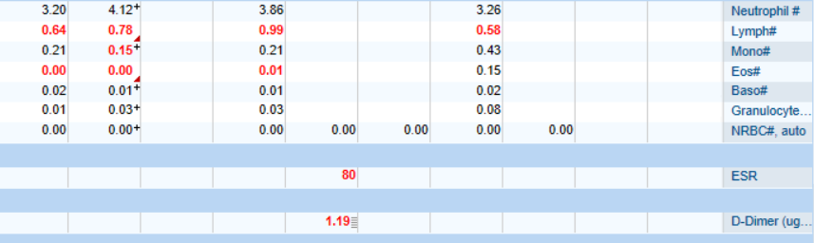
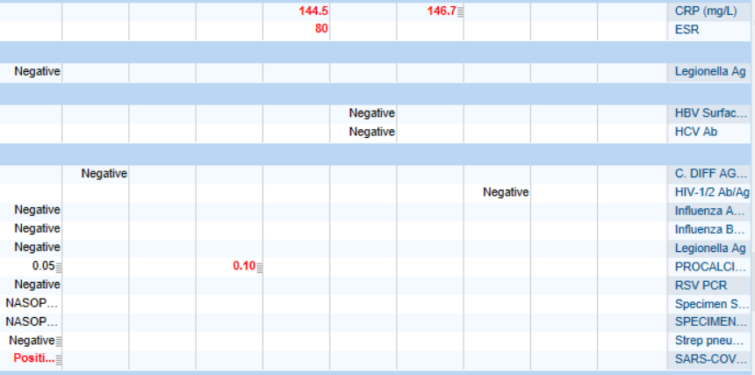


Slide 21
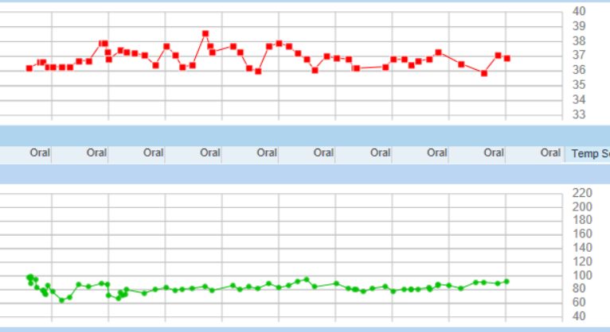
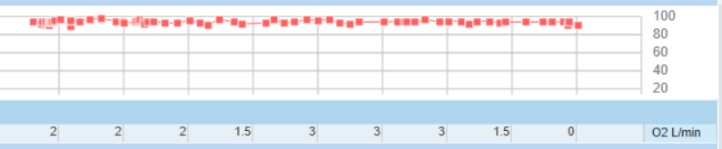

Slide 22
PEARLS
Imaging
GI symptoms
Clinical course

Slide 23
CASE III
56-year-old obese Spanish-speaking male with no significant PMH of came to ED with cough and fever.

Slide 24
56-year-old obese Spanish-speaking male with no significant PMH of came to ED with cough and fever.
* Cough with fever/ suspected COVID 19
Patient has family exposure with similar ?COVID symptoms with radiographic changes. His sister has been hospitalized also waiting for COVID 19 test.
Mild hyponatremia on admission otherwise normal electrolytes.
BNP/troponin are negative.
Lactate negative.
Negative pneumococcal and legionella antigen.
UA–negative
With fever but no leukocytosis or left shift but has lymphopenia.
Chest x-ray with findings of bilateral infiltrates.
Influenza and RSV are negative.
High suspicion for COVID 19 infection, PCR is pending.
Negative blood cultures.

Slide 25
Responded to critical response called for hypoxia, tachypnea, increased work of breathing. Interpreter service used for Spanish interpreter #353331 to speak to the patient and get information. Chart reviewed.
His respiratory status has worsened today. This evening when the evening vitals were taken, oxygen saturation had decreased to the mid 80s on 3 to 4 L of oxygen. RR was in the 20's, HR 120's. He was normotensive. He looked diaphoretic. ABG was done which showed hypoxia on NRB and chest x-ray was done which showed bilateral airspace disease compared with 3 days ago. EKG was done which confirmed sinus tachycardia, presumably due to hypoxia and increased respiratory effort.
ICU was consulted. Plan was for intubation due to worsening respiratory status in setting of presumed Covid-19 infection and transfer to ICU team.

Slide 26
PEARLS
Language barrier
RF: Sick contacts
Rapid decline
Early ICU transfer
Safe transport

Slide 27
CASE IV
49 y.o. male with a history of DM, bipolar disorder, anxiety, HTN, hyperlipidemia, who presents with fever and cough.

Slide 28
49 y.o. male with a history of DM, bipolar disorder, anxiety, HTN, hyperlipidemia, who presents with fever and cough.
No sick contacts or international travel recently.
Patient developed dry cough about 1 week ago followed by fevers for 3-4 days. He was seen by PCP and started on Z-pak.
Denies sore throat or phlegm production.
No loss of smell.
Patient then developed nausea and vomiting. Denies abdominal pain or diarrhea.
He presented to ED for further management.
VS in the Emergency room were: T 102.1, BP 138/88, HR 102, RR 22, O2Sat 88% on room air.
Blood work showed lymphopenia, hyponatremia, elevated Cr.
CXR revealed bilateral infiltrates.
Patient was tested for COVID 19 and admitted to medicine for further management.
IV fluids were started.

Slide 29
The patient is a 49 y.o. male transferred to the ICU from P4 with acute hypoxemic respiratory failure iso mutifocal PNA; COVID 19 PUI vs CAP.
Admitted to P4 yesterday with 4d hx cough and fever not improved with empiric azithro. Initially required 2L nc.
Today had increasing FIO2 needs as well as n/v but no diarrhea.
ABGs 7.44/35/113/23 on nrb on floor
ABGs 7.43/34/78/22 on hfnc 50L/0.75
Labs notable for AKI,improved cr 1.3 to 1.2
Na 127 to 135; glucose mid 100s; lfts wnl; cpk 163
Ferritin 12K; H/H 14/44; WBC 4.5K; L shift; lymphopenic
ua glucose; pct 0.02
Flu/rsv neg; strep pneumo neg; legionella neg
Transferred to ICU for close monitoring of respiratory status

Slide 30
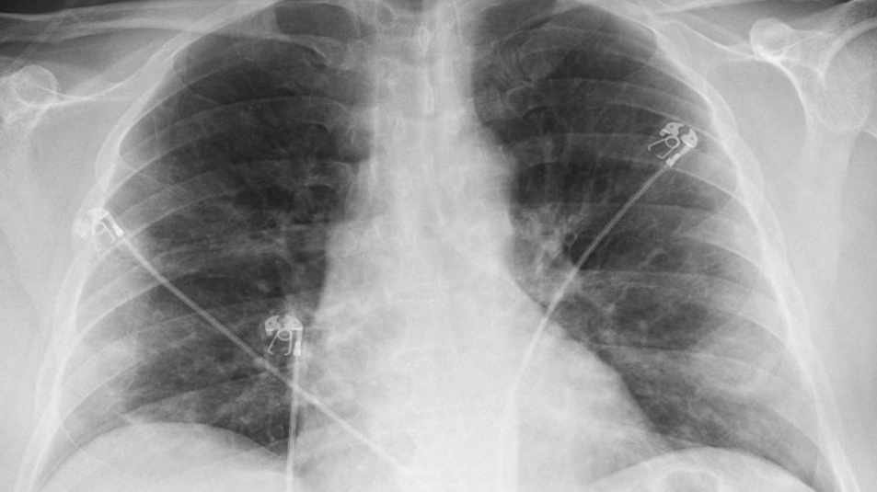

Slide 31
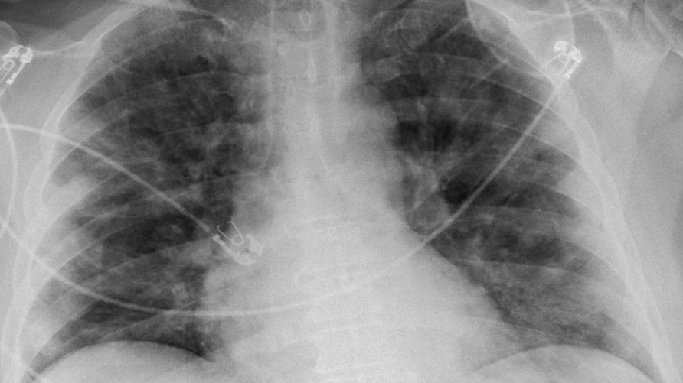

Slide 32
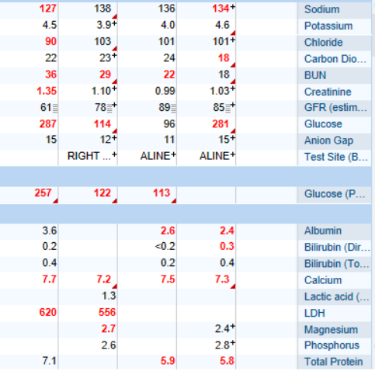
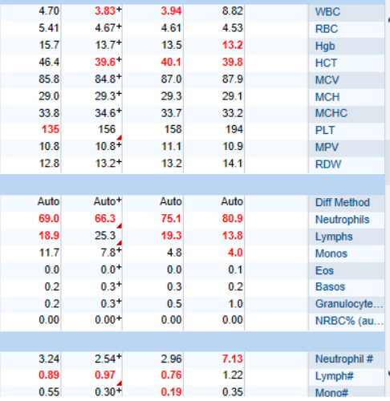
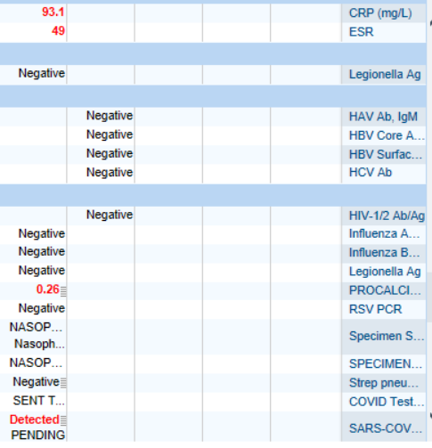
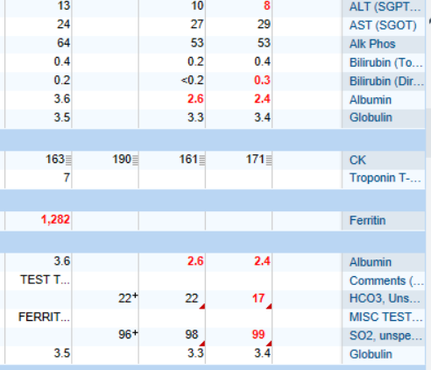
COVID19!

Slide 33
PEARLS
Prognostic Indicators:
lymphopenia, CRP, Ferritin, LDH, d-dimer, O2 needs
Early ICU Transfer
NIV vs Early Intubation

Slide 34
CASE V
84 y.o.male with h/o COPD on 4 L home O2 (FEV1 68% 6/2013), pHTN, CKD stage III (baseline creatinine 1.4-1.5), HLD, HTN, p A.fib not on AC, Remote Hx of tobacco use (quit 2012) p/w Acute on Chronic Hypoxic Respiratory Failure 2/2 AeCOPD req. Intubation (3/19-) due to COVID-19

Slide 35
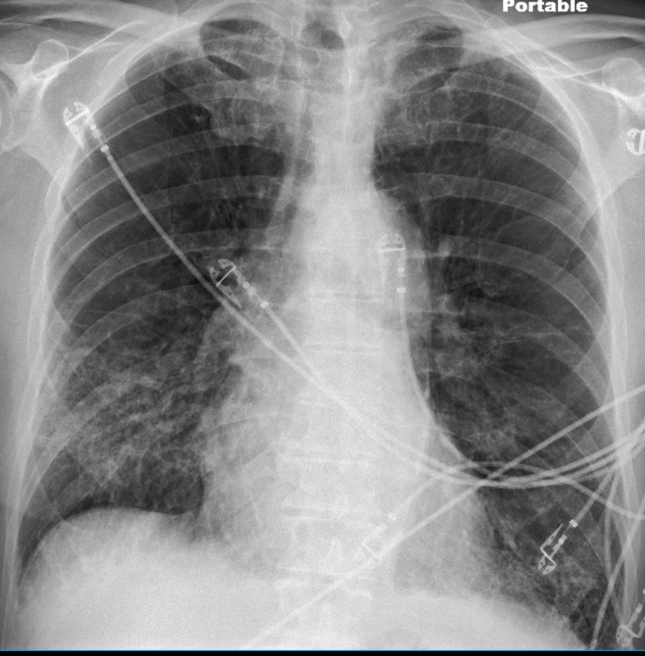

Slide 36
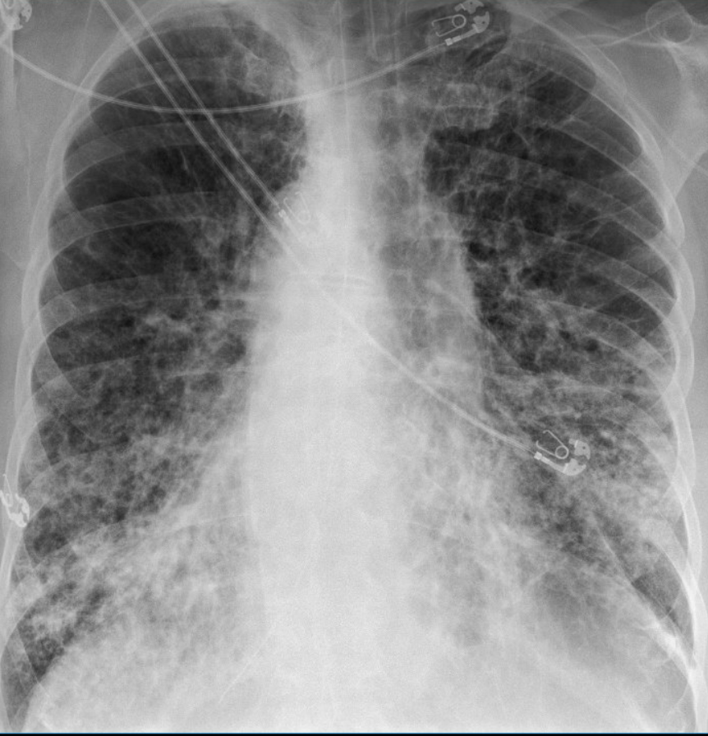

Slide 37
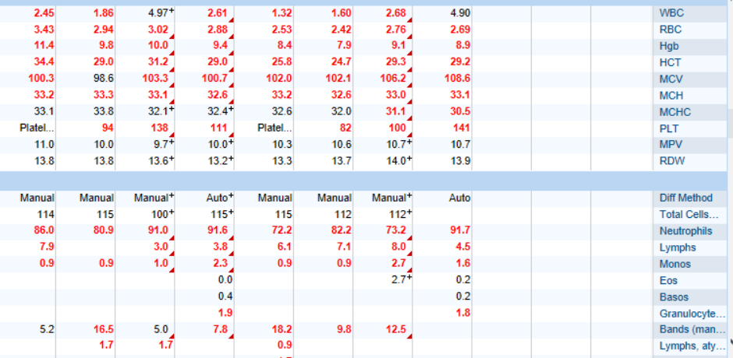
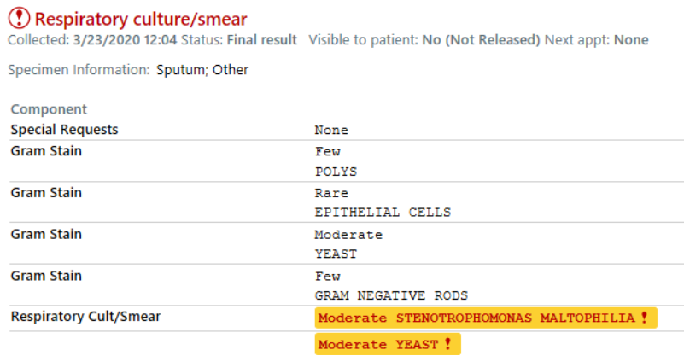
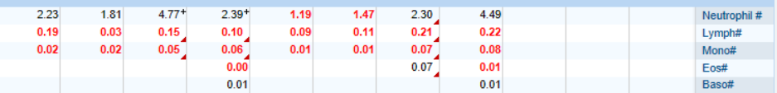

Slide 38
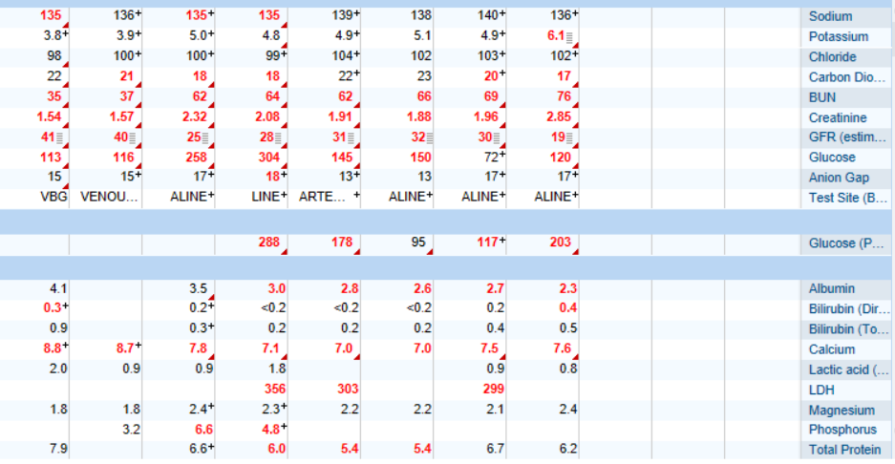
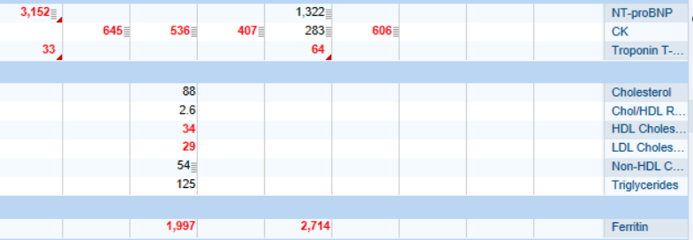
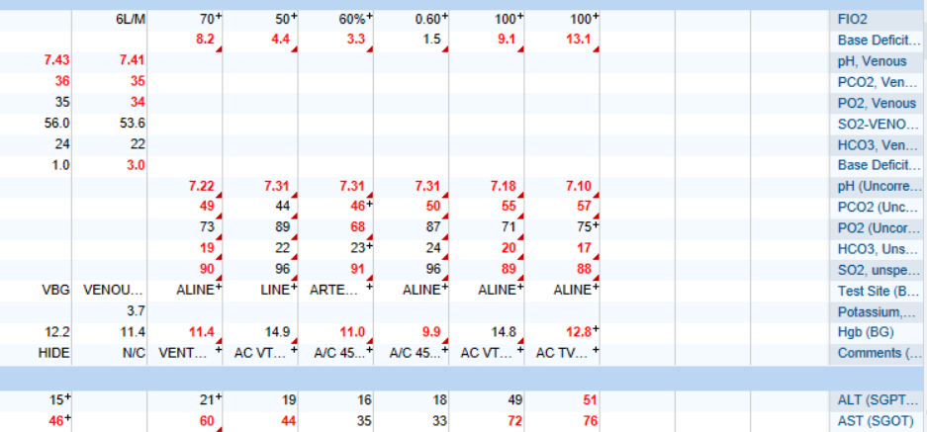

Slide 39
PEARLS
Serious Illness Conversation
Family support /communication
Provider / PEER support
Critical Care Triage – team based decisions

Slide 40

Clinical Course & Treatment Guidelines
SOURCES: BWH MGH WHO

Slide 41
BWH
POLICY
Clinical presentation: non-specific, flu-like illness
Fever (44-98%)
Cough (46-82%)
Shortness of breath (20-64%)
Upper respiratory symptoms, nasal / sinus congestion (5-25%)
GI symptoms (10%; usually before respiratory symptoms)
Transmission:
Large droplets and fomites
Viral particles survive < 24h on cardboard, < 72h on plastic or steel (van Dorelmalen et al, New Engl J Med, 2020)
Aerosols (droplet nuclei, < 5 µm), estimated < 4h
Incubation period: median 4 days, common range 2-7 days, up to 24 days
Symptomatic and asymptomatic patients can transmit the virus
Disease Course:
~ 80% do not require critical care
~ 10-20% develop bacterial superinfection
~ 2-25% have respiratory viral co-infection (Qingdao, China: Xing et al, medRxiv, 2020 preprint; Stanford, CA, USA: Shah N, M, 2020 unpublished data)
~ 20% develop ARDS
~ 5% develop renal injury requiring renal replacement therapy
Elevated AST / ALT (~200s) is common; fulminant hepatitis not reported
Cardiomyopathy in critically ill patients; some progress to cardiogenic shock late in course (anecdotal reports)
Reasons for ICU admission:
Hypoxemic respiratory failure is the most common indication for ICU.
Reports of rapid progression to intubation within 12-24h
Few patients with shock, can develop late in course
Median time from symptom onset to ICU transfer is ~10 days
Poor prognostic indicators:
Demographics: Age > 65, male
Comorbidities: cardiovascular disease (includes hypertension), pulmonary disease, diabetes, malignancy, immunosuppression
Lab findings: severe lymphopenia, elevated troponin, elevated creatinine, elevated LDH, elevated CRP, elevated D-dimer
Cause of death:
~53% respiratory failure. ~33% concomitant respiratory and heart failure. ~7% cardiac or heart failure alone
Mortality rate appears to correlate with age and availability of medical resources (Ruan et al, Intensive Care Med, 2020)

Slide 42
BWH
POLICY
Inpatient (non-ICU) Management Principles
Diagnostic studies:
Labs & EKG:
On admission: CBC with differential, BMP, LFTs, LDH, CRP, D-dimer, Troponin / CPK, PTT / INR, Procalcitonin, baseline EKG
Daily: CBC with differential, BMP
For stable floor patients, consider every other day
Every other day: LFTs, LDH, CRP, D-dimer, Troponin / CPK (if in ICU), Triglycerides (if on propofol)
If clinical worsening: LFTs, LDH, CRP, D-dimer, Troponin, CPK, PTT / INR, Procalcitonin, Ferritin, Fibrinogen, EKG
Expert opinion does not recommend routine pro-BNP.
Chest imaging: Portable CXR is sufficient in most cases. Avoid routine daily CXR (unlikely to change management, evaluate case-by-case).
Chest imaging variable; bilateral patchy opacities most common
Chest CT often will not change treatment; obtain only if necessary (risk of transmission, time associated with transport / decontamination of equipment)
Point of Care Ultrasound of the lungs can be used but by experienced providers only
Obtain additional studies only if necessary
Avoid routine TTEs (for cardiac studies, see: “Cardiac Complications of COVID” chapter).
Medical management: Largely supportive
Fluid management should be conservative due to risk of hypoxia/CHF
Antiviral and immune-modulating therapies are investigational
Early Advance Care Planning:
In conscious patients, review or sign Health Care Proxy form
Discuss and document goals of care on admission
Educate patient and family on disease course
Focus on desired quality of life and tolerance for ICU measures
Avoid implying availability of ICU measures if unknown (refer to local ethics guidance)
Consult the ICU team EARLY for:
  Provider concern
  Respiratory distress
  Need O2 > 6 LPM to maintain SpO2 > 92 or PaO2 > 65.
  Rapid escalation of oxygen requirement.
  Significant work of breathing.
  Hemodynamic instability after initial conservative fluid resuscitation
  SBP < 90, Mean arterial pressure < 65, or Heart rate > 120.
  Acidosis
  ABG with pH < 7.3 or PCO2 > 50 or above patient’s baseline.
  Lactate > 2.
  Need for intensive nursing care or frequent laboratory draws requiring arterial line.
  Severe comorbid illness / high risk for deterioration.

Slide 43
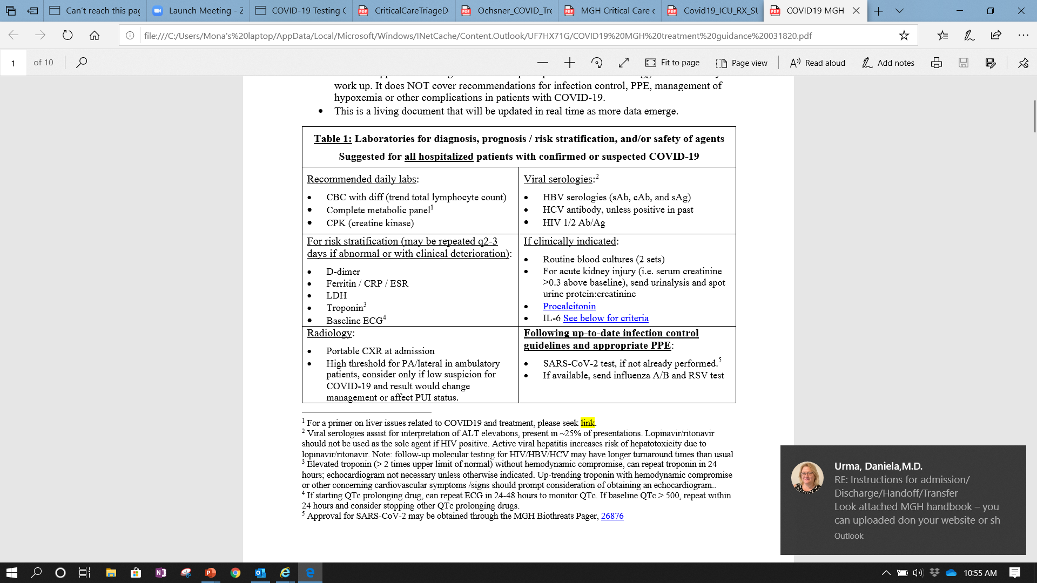
MGH
GUIDANCE

Slide 44

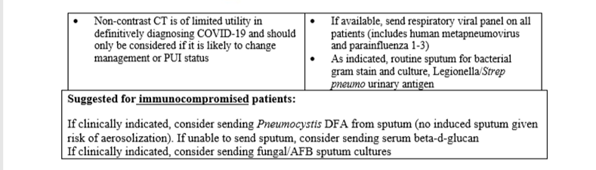
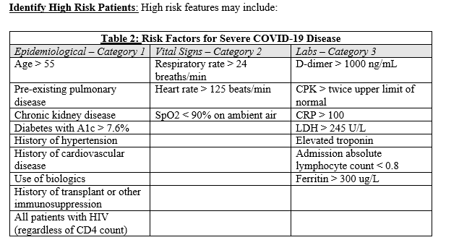

Slide 45
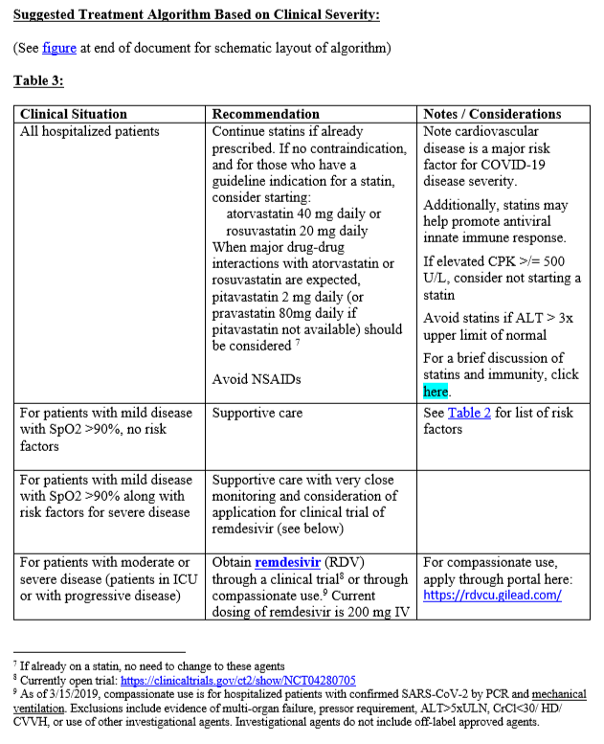
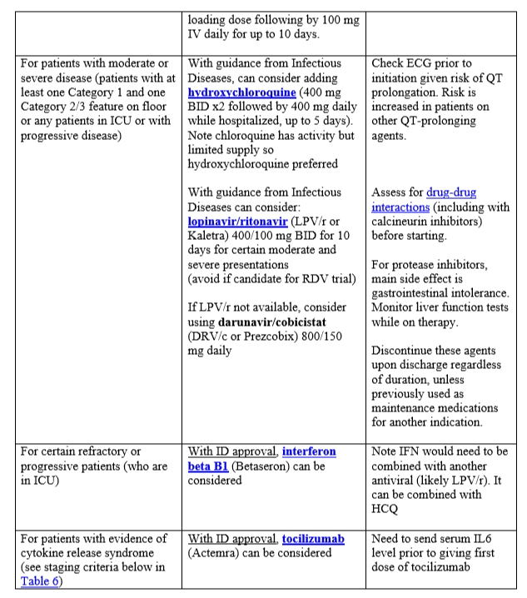

Slide 46
Thank you

Slide 47
APPENDIX
Additional Topics

Slide 48
Universal Masking/Screening to began Wednesday
All must use Davenport 1 to enter Salem Hospital
Universal Masking: All must enter the hospital through Davenport 1 entrance for mandatory screening and masking. Badge access will not work at any entrances and no one will be permitted to enter through the North Shore Children’s entrance with the exception of patients. The best place to park is lot G behind the hospital.
Self Monitoring: The attestation form can be filled out on your smartphone by going to www.partners.org/covidpass. Screeners available at Davenport 1 to complete the form for you. You may also visit this website from your home computer and print.
Please plan accordingly to allow sufficient time since there will be delays.

Slide 49
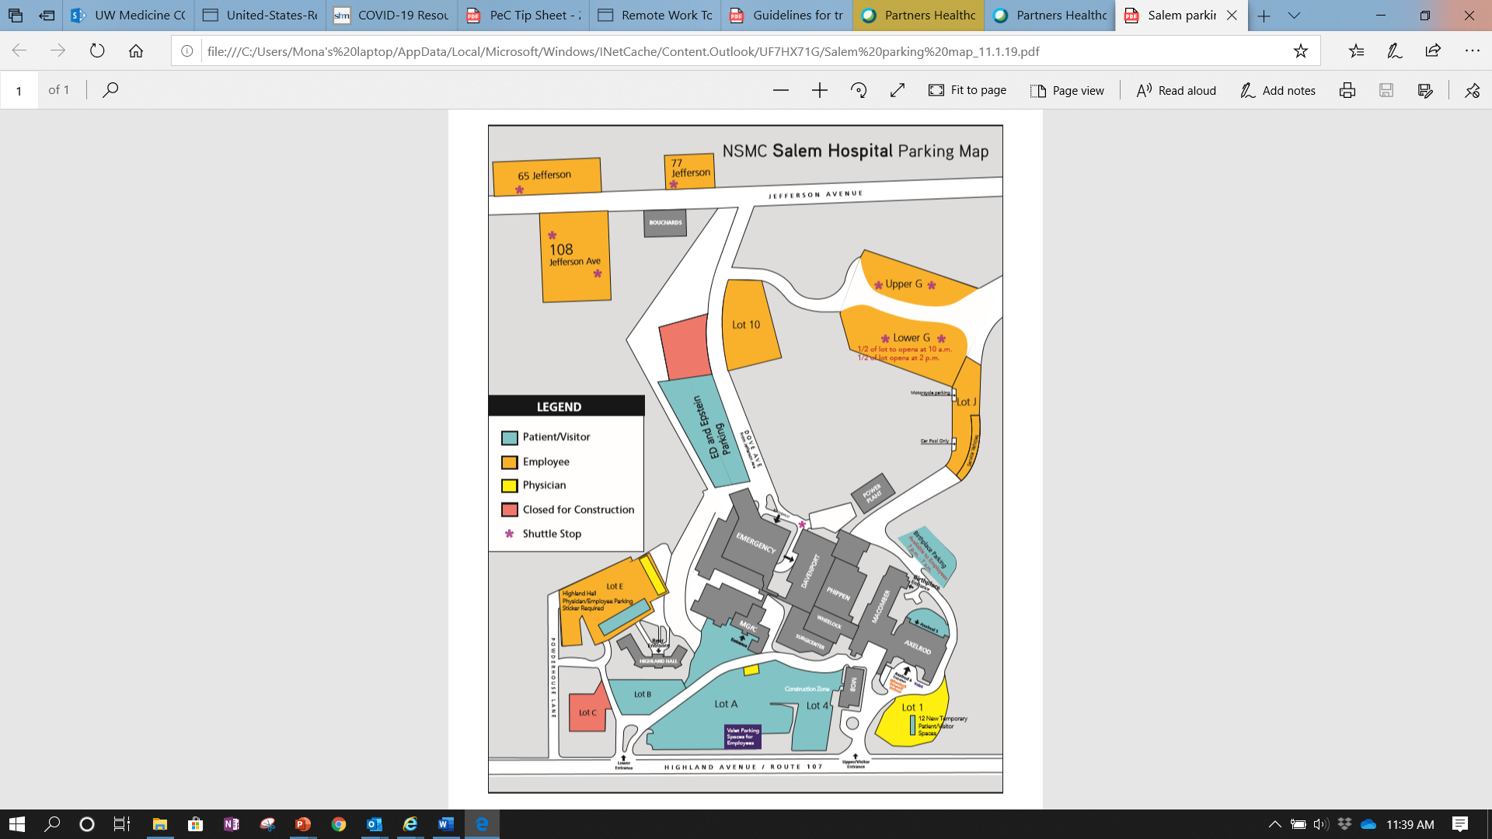

Slide 50

Employee Alert System
You should have received this notification via text, phone call and/or by email from our Emergency Alert System.
If you did not receive notification, please reach out to Katherine. She will guide you to a step by step guide to set it up.
It is important that you are notified of any urgent changes on a timely basis.

Slide 51
Work Attire and COVID-19
Effective: March 24, 2020
Approved: March 24, 2020
See All COVID-19 Policies on Policy Central (Archer)
Purpose
To affirm existing dress code and attire policies during the COVID-19 pandemic response.
Policy
Use of personal protective equipment (PPE) is the established and accepted mechanism to protect yourself and your clothing from contamination when caring for patients on specified precautions, including those for COVID-19 patients. There is no evidence that wearing clothing that has been properly protected by PPE poses a risk for transmission of COVID-19 to others. Similarly, shoes do not represent a concern for transmission of the virus.
While employees may choose to change clothing attire prior to or after shifts at work, it is not necessary from an infection control perspective.

Slide 52
EPIC TOOLS

Slide 53
COVID19 TESTING
Effective March 24, 2020
Option 1 Asymptomatic screening:
Partners HealthCare worker requiring return to work clearance per Occupational Health Services
Organ Donor (Donations for New England organ bank requiring testing)
Patients presenting in extremis and no history able to be obtained
Retest patients with indeterminate/inconclusive COVID-19 result
Patients undergoing urgent airway surgery within the next 48-hours that cannot be deferred
Patients requiring urgent transplants within the next 48-hours (solid or liquid)
Option 2 Symptomatic testing:
At least one of the following, potentially attributable to a respiratory viral illness:
Fever, subjective or documented
New sore throat
New cough
New runny nose or nasal congestion
New shortness of breath
Muscle aches
New anosmia
And at least one of the following (this is a prioritized list based on capacity):
Inpatients
Emergency department patient requiring admission
Emergency department or Respiratory Illness Clinic (RIC) high risk* patients not requiring admission
Partners HealthCare employee who is required to work at a clinical site
Patient cared for by symptomatic Partners HealthCare worker with confirmed COVID-19
Household contacts of a Partners HealthCare employee who is required to work at a clinical site
Retest patients with indeterminate/inconclusive COVID-19 result
Homeless individuals regardless of whether or not they are part of a cluster or had contact with a confirmed case
Patients receiving dialysis
*High Risk is defined: Age >70
Age ≥70
Severe chronic lung disease (e.g. asthma, bronchiectasis, cystic fibrosis, COPD, bronchopulmonary dysplasia, Cerebral Palsy with recurrent pneumonia, trach dependency, etc.)
Severe heart disease (including congenital heart disease)
CD4 count <200
On immunocompromising medications (e.g. prednisone >20mg/d, chemotherapy, mycophenolate, cyclosporine, azathioprine, tacrolimus, TNF inhibitors, monoclonal antibodies, etc.)
Long- term care facility or group home setting

Slide 54
COVID-19 ISOLATION AND TESTING PANEL
The ED/Inpatient COVID-19 ISOLATION AND TESTING PANEL is now orderable in the ED and Inpatient settings at NSMC.
This includes the correct orders for Isolation Precautions and the COVID-19 PCR lab test. COVID-19 ISOLATION AND TESTING PANEL by searching Orders for “COVID” in the Facility List.
Ordering this test no longer requires approval. There is no need to page Biosafety.

Slide 55
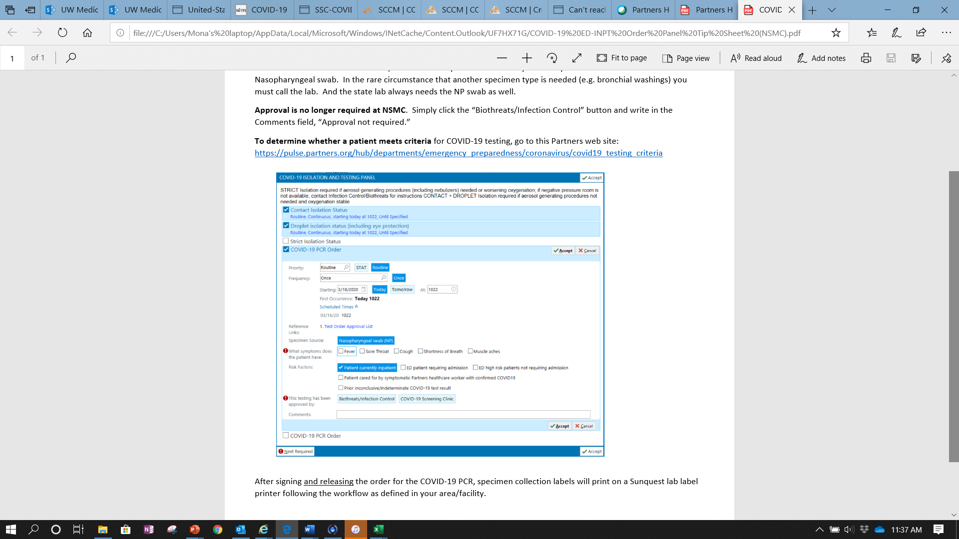

Slide 56
DISCONTINUING ISOLATION
Discontinuation of CoV-Risk Infection Status
1. Discontinuation of the CoV-Risk Infection Status requires approval from local Infection Control/Biothreats leadership.
2. In the setting of high clinical suspicion for COVID-19 despite negative test result(s), CoV-Risk will be maintained through hospitalization.
3. If clinical suspicion for COVID19 is low then the CoV-Risk Infection Status can be discontinued after a single negative COVID-19 test if an alternative, non-infectious diagnosis has been established (e.g., pulmonary embolism, bacterial pneumonia without concern for viral prodrome or superinfection)
4. Otherwise, CoV-Risk Infection Status can be discontinued in the following circumstances
1. Two negative nasopharyngeal swabs taken >24 hours apart (sensitivity of single negative NP = 70%), or
2. One negative nasopharyngeal swab andone negative lower respiratory sample (endotracheal aspirate or bronchoalveolar lavage). These may be drawn within a 24 hour period. Note that an expectorated sputum sample does NOT count.
Discontinuing Contact + Droplet Isolation, for patients previously CoV-Risk
a. Discontinuation of the Contact + Droplet Isolation requires approval from local Infection Control/Biothreats leadership.
b. The following are required :
i. Patient has met criteria above for discontinuation of CoV-Risk
ii. All respiratory viral illness tests ordered are negative (flu/rsv, other viral respiratory tests).
iii. Team no longer suspects a respiratory viral illness because an alternative, non-infectious diagnosis is established (e.g., pulmonary embolism, bacterial pneumonia without concern for viral prodrome or superinfection)
Discontinuing Contact + Droplet Isolation, for patients never considered for CoV-Risk
c. Discontinuation of the Contact + Droplet Isolation requires approval from local Infection Control/Biothreats leadership.
a. The following are required:
i. All respiratory virus tests ordered are negative (influenza & RSV as well as any additional respiratory viruses ordered) and one or more of the following criteria are met:
1. CT chest without parenchymal infiltrates (sensitivity of infiltrates on chest radiograph = 59%, CT chest = 86%) or
2. Procalcitonin >0.5ng/ml (sensitivity of PCT ≤0.5 = 94%) or
3. Team no longer suspects a respiratory viral illness because an alternative, non-infectious diagnosis is established (e.g., pulmonary embolism, bacterial pneumonia without concern for viral superinfection)
Discontinue Contact + Droplet Isolation by contacting Infection Control or Primary MD + senior MD (B. Lambl, R. Shah, A. Bensaci, M. Hinrichsen, J. Byrne, P. Gordan, P. Lee, or P. Rice). Documentation in EPIC outlining the 2 MD review and specific criteria used to remove precautions is required. Please see attached document for greater detail.

Slide 57
HOSPITALIST BEST PRACTICES COVID19
Hospital Medicine Preparedness Plans
Transition of D5 to INPT & ICU COVID suspect / positive DONE
Next floor to consider transitioning a cohort of INPT COVID suspect / positive PINGREE
Identify team of providers who will lead this effort STARTED/ONGOING
Create Inpatient Guides for Patients with COVID ONGOING – please see MGH guidelines attached and provide feedback
Keep up with up-to-date Hospital Medicine recommendations ONGOING
Guidelines at time of DISCHARGE STARTED (led by Justin & Daniela). See attached COVID Isolation Instructions. More ahead
Contingency Planning STARTED thanks to many who have stepped up to be a part of this team.

Slide 58
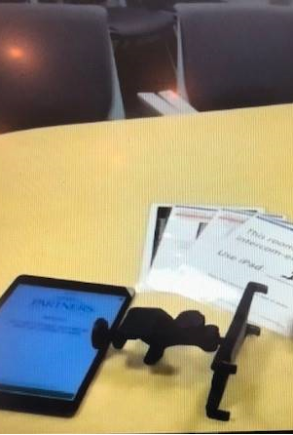
VIRTUAL CONSULTATION
If the requesting MD and the consultant agree that in-person evaluation is not required, the consultation may be provided virtually.
Virtual consultants should obtain as much clinical information as possible from all sources. This may include use of photographs provided by the requesting service uploaded into the electronic medical record (EMR) or sent by text or email. Virtual evaluation of the patient may include telephone conversation, or other audio or visual technology, such as Skype for Business and Facetime, as approved by Health and Human Services. (See Notification of Enforcement Discretion for telehealth remote communications during the COVID-19 nationwide public health emergency regulation here: https://www.hhs.gov/hipaa/for-professionals/special-topics/emergency-preparedness/notification-enforcement-discretion-telehealth/index.html).
After virtual consultation the consultant will then review the case with the requesting service by direct MD to MD communication by telephone or text. At this time, it may be determined that the patient should be evaluated in person. If the requesting MD believes the patient should be evaluated in person, the consultant will come to the unit and perform in-person consultation. Disagreements or concerns should be escalated to the relevant Department Chair.
Once completed, the encounter will be documented in the EMR.

Slide 59

IP eConsults
Inpatient order has been escalated to High Priority. PeC is currently working on the request.
TIP Sheet soon to come!
List of Inpatient eConsult orders to be created:
IP Endocrinology eConsult
IP Infectious Disease eConsult
IP Nephrology eConsult

Slide 60
COVID19 CRT Teams
Inside the ROOM
Outside the ROOM
CRT Leader: Hospitalist vs STAT RN
RN1: monitor + medication administration
Case Dependent
??Hospitalist/Resident MD
RT
IV for access + labs
Radiology
Equipment
EKG
Portable X-ray
??? responsible for:
  Standing at the door of the room.
  Confirming need for each individual
  Ensuring that all who are entering the room only do so after donning appropriate PPE.
  Assisting with communication between those in the room and those outside of the room.
Runner (remains outside the room and fetches required material)
Watcher to observe Doffing after the CRT
Equipment: Epic express computer

Slide 61
General Rules
CRT
All caregivers MUST be donned in appropriate PPE
STAT RN to decide if MD is to be called ???
If respiratory distress: LOW THRESHOLD to call CODE TEAM
LOW THRESHOLD for call INTUBATION. SECURE AIRWAY FIRST to protect the team. Airway to be prioritized. ABC rather than CAB
CRT Leader to notify family
Use staff log to monitor who is in and out of the room.

Slide 62
Statement on transporting COVID-19 suspect or confirmed patients in the hospital who require oxygen and/or non-invasive ventilation
Background: The use of bag valve mask ventilation, non-invasive ventilation (CPAP, BiPAP), high flow nasal cannula and venturi masks are aerosolizing interventions. For persons under investigation (PUI) for COVID-19 and COVID-19 confirmed patients, aerosolizing interventions should be avoided if possible, and when necessary occur in a negative pressure environment given the risk to the healthcare workforce.
Statement: Given the concern about aerosolization and risk to the healthcare workforce, a PUI or confirmed COVID-19 patient cannot be transported through the hospital on non-invasive ventilation, bag valve mask ventilation, high flow nasal cannula or a venturi mask. In these circumstances, the patient can be assessed with a non-rebreather oxygen mask or nasal cannula and if their hemodynamics and oxygenation are safe, then they can be transported on a non-rebreather oxygen mask or nasal cannula until they get to a negative pressure environment. During transport, a surgical mask needs to be placed over the nasal cannula or non-rebreather oxygen. If the patient does not tolerate non-rebreather oxygen or nasal cannula, then they need to be intubated for transport with a portable ventilator.

Slide 63
Resources
EAP Tips on Managing the Fear of Coronavirus
Create an emergency plan to prepare for the Coronavirus
Talking with Children about the Coronavirus Pandemic: 7 Ways to Support Kids and Teens Through the Coronavirus Pandemic
EAP availability and Mini-Sessions on Relaxation
MGH Guide to COVID-19 Mental Health Resources
McLean Hospital article on Caring for your Mental Health During COVID-19 and Five Ways to Reduce Anxiety During the COVID Outbreak

Slide 64
COVID 19 Treatment Current State
Matt Basciotta
Noon Conference
3/25/20

Slide 65
Goals
Current state of potential COVID 19 treatments
Discuss literature and evidence behind recommendations
Future directions

Slide 66



Sources

Slide 67
Early identification
Clinical presentation: non-specific, flu-like illness
  Fever (44-98%)
  Cough (46-82%)
  Shortness of breath (20-64%)
  Upper respiratory symptoms, nasal / sinus congestion (5-25%)
  GI symptoms (10%; usually before respiratory symptoms)

Slide 68
Diagnosis
Clinical presentation: non-specific, flu-like illness
  Fever (44-98%)
  Cough (46-82%)
  Shortness of breath (20-64%)
  Upper respiratory symptoms, nasal / sinus congestion (5-25%)
  GI symptoms (10%; usually before respiratory symptoms)
Early diagnosis and initiation of quarantine and precautions is the best treatment for future cases
Goals of care conversation

Slide 69
Reduce risk of transmission
Non-Invasive Positive Pressure Ventilation (NIPPV: BiPAP, CPAP), High Flow Nasal Cannula, Humidified Venturi Face Masks, Nebulizers increase aerosolization
Should be done under negative pressure, strict isolation
Its difficult to prove these modalities increase risk of transmission

Slide 70
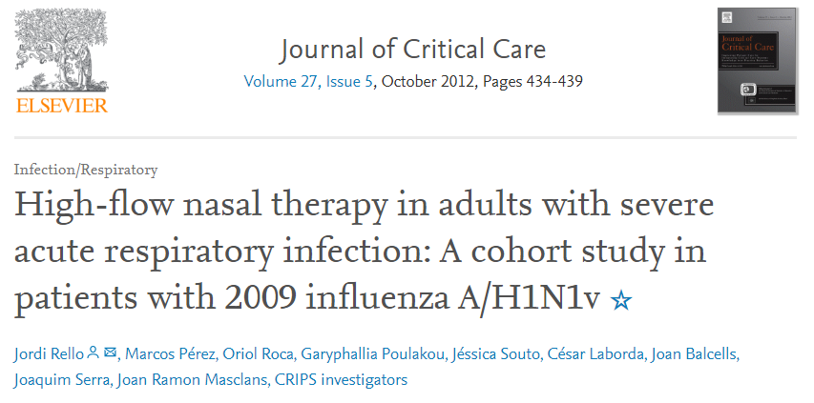

Slide 71
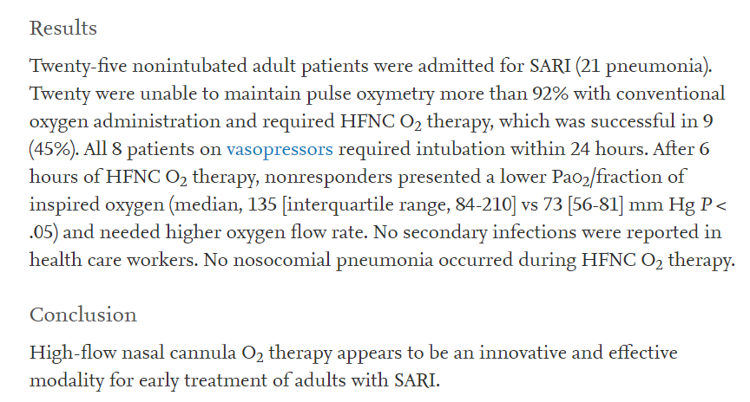

Slide 72
Reduce risk of transmission
Consider early intubation given high failure rate of NIV methods in reports from China

Slide 73
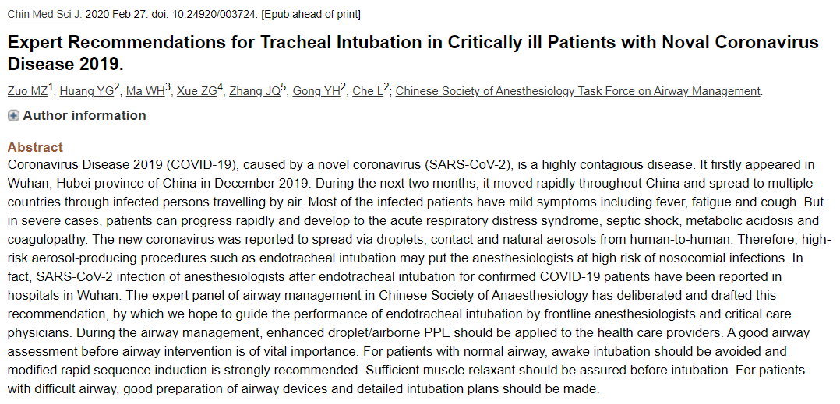

Slide 74
Managing Ventilation
Mainstay of management is ARDSnet protocols and our usual ventilation strategies
Use of proning in severe cases
Stay tuned for more

Slide 75

Ok, but what about drugs?

Slide 76
Antibiotics and Co-Infection
Co-infection with influenza or bacteria can occur (10-15%)
Often this is associated with calcitonin levels > 0.5, which would be unusual for COVID alone
Use usual appropriate antibiotic choice
  Assess for drug resistant risk factors, history of MRSA, pseudomonas etc.

Slide 77
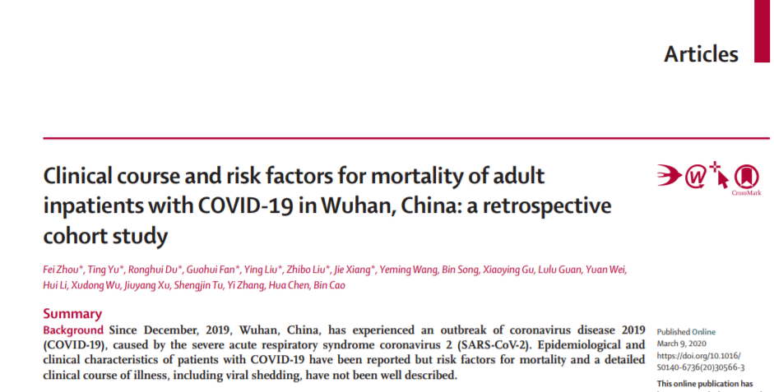

Slide 78
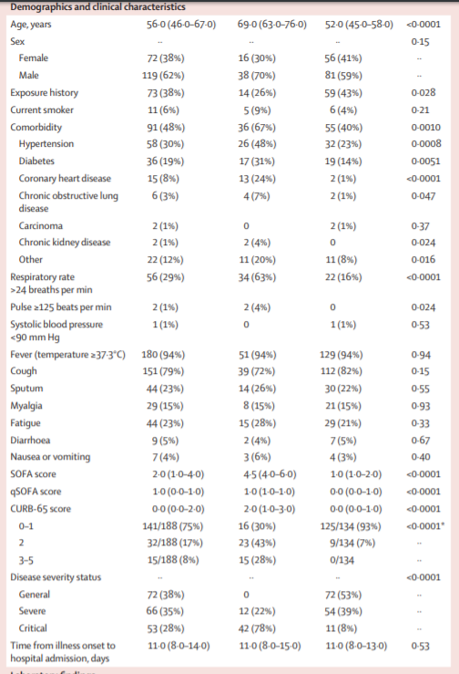
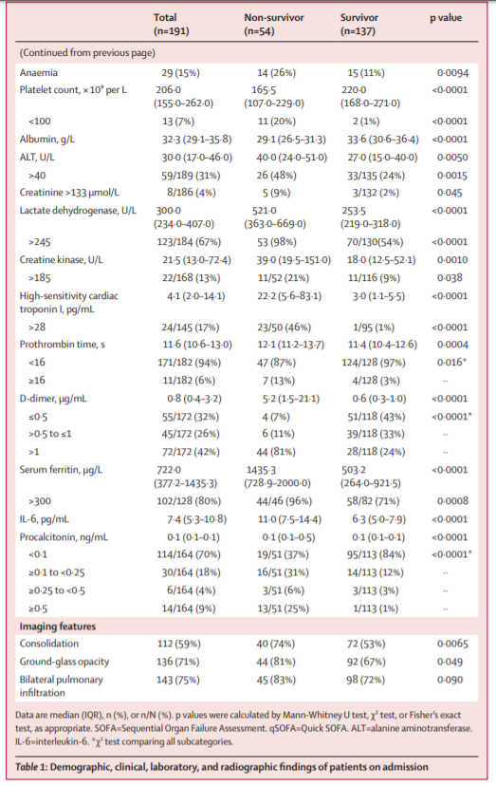

Slide 79
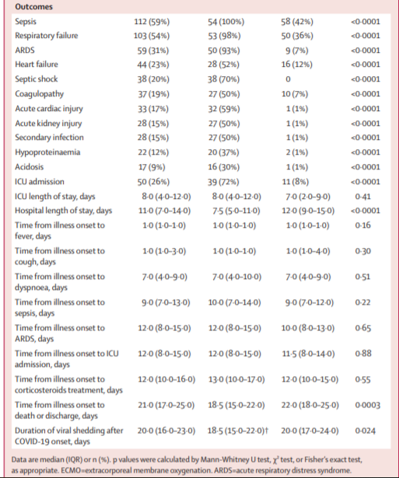
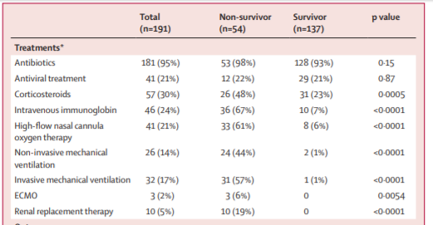

Slide 80
Longest time of viral shedding was 37 days!

Slide 81
Inhaled Pulmonary Vasodilators
No data in COVID patients
Do not reduce mortality in ARDS in other circumstances
Only in severe ARDS in conjunction with prone ventilation, and RV failure

Slide 82
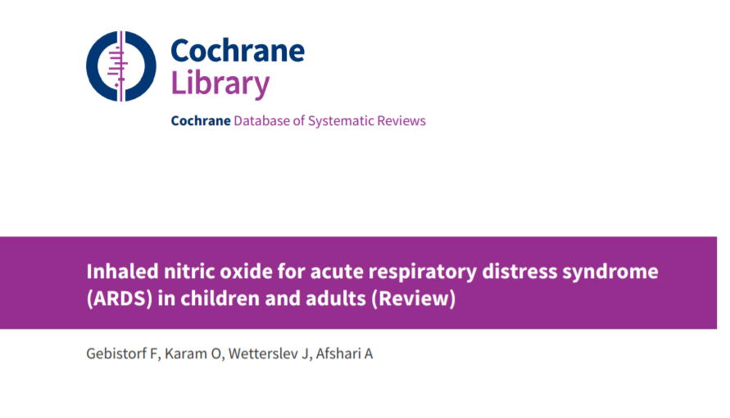

Slide 83
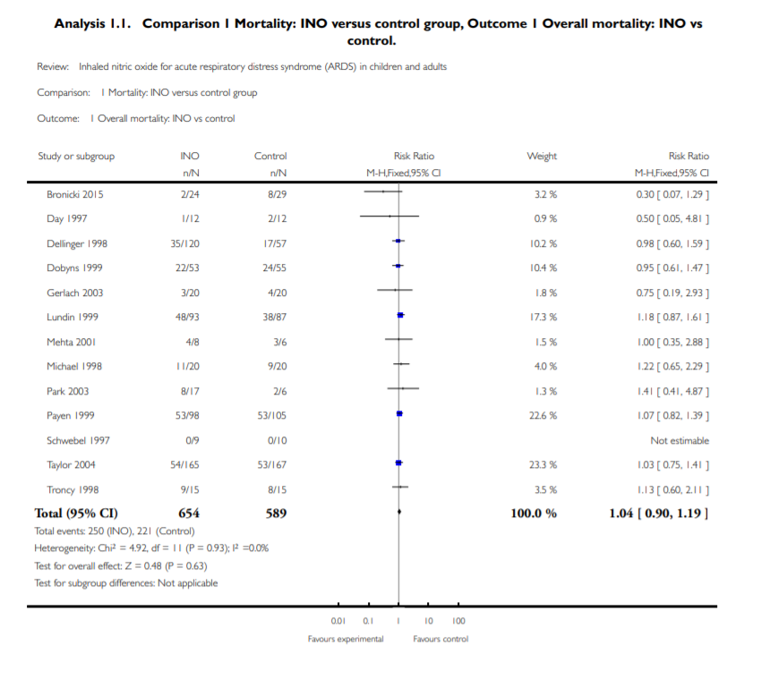

Slide 84
Corticosteroids
Previously there was no evidence of benefit from steroids in SARS-CoV, MERS-CoV or influenza infection
Observational data show increased mortality, more secondary infections, impaired viral clearance and more adverse effects in survivors
However retrospective analysis of 201 patients with high proportion ARDS showed benefit
Not currently routinely used at MGH/BWH

Slide 85
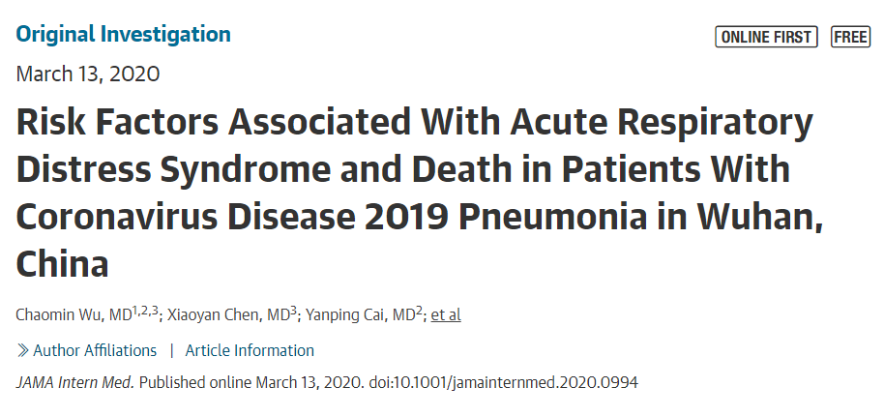
Corticosteroids
Previously there was no evidence of benefit from steroids in SARS-CoV, MERS-CoV or influenza infection
Observational data show increased mortality, more secondary infections, impaired viral clearance and more adverse effects in survivors
However retrospective analysis of 201 patients with high proportion ARDS showed benefit
Not currently routinely used at MGH/BWH

Slide 86
Anti-IL6 Agents (Tocilizumab, Siltuximab)
Anecdotal reports from China and Italy
No retrospective or prospective analysis done yet
Used at BWH/MGH for COVID patients with concomitant cytokine release syndrome

Slide 87
Hydroxychloroquine and Chloroquine
Both have been found to have activity against RNA viruses including COVID19 in virto
Hydroxychloroquine > chloroquine
China expert consensus group reported that chloroquine improved lung imaging and shortened disease course
Chloroquine will become part of China’s guidelines for COVID treatment in the future

Slide 88

Hydroxychloroquine and Chloroquine

Slide 89

Hydroxychloroquine and Chloroquine

Slide 90

Hydroxychloroquine and Chloroquine

Slide 91

Hydroxychloroquine and Chloroquine

Slide 92

Hydroxychloroquine and Chloroquine

Slide 93

Hydroxychloroquine and Chloroquine

Slide 94
Hydroxychloroquine and Chloroquine
Currently being used in some or most COVID positive patients at BWH, BMC, NYU among others
I have not heard of data with azithromycin being used alone

Slide 95
Remdesivir (and other antivirals)
Clinical trials currently underway
Stay tuned…

Slide 96

Drugs to avoid?

Slide 97
ACEi and ARBs
SARS-CoV-2 binds to cells via ACE2, which is potentially upregulated by ACEi, ARBs and NSAIDs
The American College of Cardiology, American Heart Association and Heart Failure Society of America joint statement recommends against discontinuing ACE-I and ARBs in patients with COVID-19
Data collection regarding safety underway

Slide 98
NSAIDs
SARS-CoV-2 binds to cells via ACE2, which is potentially upregulated by ACEi, ARBs and NSAIDs
Unpublished reports from France and England regarding worsening disease
Recommend use with acetaminophen preferentially until there is more data, however WHO has not recommended against NSAIDs as of 3/20/20

Slide 99
Conclusions
Early identification and isolation is essential
Hydroxychloroquine is the most promising currently available medication
Antiviral clinical trials currently ongoing
Continue ACEi/ARBs, use acetaminophen before NSAIDs

Slide 100
Questions?

Slide 101

Contingency Planning
Hospitalist-Intensivist
Awais Alam
Matt Basciotta
Maria Betancourt
Justin Byrne
Tariq Hashmi
Pat Lee / Joe Miaskiewicz
Sandeep Mishra
Elvis Patel
Michael Pham
Santosh Poudel
Maria Ratchkova
Maria Rupnick

Slide 102
Contingency Planning
PCP / Consultants / Extended care
NSPG PCPs
Charter Health
Cardiology
Gastroenterology

Slide 103
COVID 19:
MD CONTINGENCY PLAN

Slide 104
Critical Care Privileging
The hospital's President, Chief Medical Officer, or their designee is authorized to grant emergency privileges for licensed independent practitioners (LIPs) when its emergency operations plan is activated and the organization is unable to handle immediate patient-care needs. Ongoing oversight of care treatment and services by the volunteer LIP is required and a local entity responsibility.

Slide 105

CRICO Coverage

Slide 107
CURRENT STATE for ICU level of care 1-25: DAY
DAV 6
DAV 5/DAV6
ICU
ATTENDING
RANGER
ICU Attending
ICU Attending
Senior Resident
2 PGY-1s
Jeopardy Senior Resident
1 to 25 Patients
Notes:
Adds 1 senior resident to Dav 5 using a jeopardy system to trigger the extra senior resident. Trigger to call extra resident is decided between ICU attending and Resident PD at 6am
ICU ranger = float and assist / admissions, procedures, codes
Resident Change to next level at 21 Patients

Slide 108

CONTINGENCY for ICU level of care 25-30: DAY
DAV 6
DAV 5/DAV6
ICU Attending
ICU Attending
Ranger/Rounder
ICU Attending
Senior Resident
1 PGY-1
Senior Resident*
25 to 30 Patients
Notes:
ICU Ranger/Rounder picks up ~5 patients to extend to 30
Resident changes happen at 21 patients.
* Extra senior resident is scheduled now, not anymore using a Jeopardy system to trigger the extra senior resident.

Slide 109
CONTINGENCY for ICU level of care 25-30: NIGHT
2 ICU Attendings
DAV 6
DAV 5/DAV6
Senior Resident*
PGY-1
Senior Resident*
25 to 30 patients
Notes:
Adds 2nd ICU attending

Slide 110

CONTINGENCY for ICU level of care 30-40: NIGHT
Night team 1
Ranger Team
Anesthesiologist with senior resident
20 Patients
ICU Attending
PGY-1
Notes:
Night Team 1: ICU + DAV5- DAV 5 south, OR-PACU.
Ranger team: Procedures, Admissions, codes
Floor Teams will not have seniors

Slide 111
CONTINGENCY for ICU level of care 30-40: DAY
ICU Attending
Non ICU Attending + Senior Resident
Non ICU Attending + Senior Resident
Non ICU Attending + Senior Resident
Non ICU Attending + Senior Resident
10 Patients
10 Patients
10 Patients
10 Patients
Rounding team
Ranger Team
ICU Attending
PGY-1
Notes:
Non ICU attending = selected hospitalists, closer to training and/or comfortable with higher acuity care

Slide 112
CONTINGENCY for INPATIENTS 140-180: DAY
Rounding team
HOSPITALIST
HOSPITALIST
HOSPITALIST
HOSPITALIST
15 Patients
15 Patients
15 Patients
15 Patients
HOSPITALIST ONLY TEAMS
HOSPITALIST + INTERN
HOSPITALIST + INTERN
HOSPITALIST + INTERN
HOSPITALIST + INTERN
20 Patients
20 Patients
20 Patients
20 Patients
HOSPITALIST WITH INTERN TEAMS
Ranger Team
On Call HOSPITALIST*
HOSPITALIST*
PCP
PCP
PCP
PCP
10 Patients
10 Patients
10 Patients
10 Patients
PCP TEAMS
Notes:
Ranger hospitalist floats and assists / supports PCPs
Ranger = AOC or other experienced hospitalist

Slide 113
CONTINGENCY for INPATIENTS 181-220: DAY
Rounding team
HOSPITALIST
HOSPITALIST
HOSPITALIST
HOSPITALIST
15 Patients
15 Patients
15 Patients
15 Patients
HOSPITALIST ONLY TEAMS
HOSPITALIST + INTERN
HOSPITALIST + INTERN
HOSPITALIST + INTERN
HOSPITALIST + INTERN
20 Patients
20 Patients
20 Patients
20 Patients
HOSPITALIST WITH INTERN TEAMS
Ranger Team
On Call HOSPITALIST*
HOSPITALIST*
PCP
PCP
PCP
PCP
10 Patients
10 Patients
10 Patients
10 Patients
CONSULTANT + NP
CONSULTANT + NP
CONSULTANT + NP
CONSULTANT + PA
10 Patients
10 Patients
10 Patients
10 Patients
HOSPITALIST*
PCP TEAMS
CONSULTANT + PA/NP TEAMS
Notes:
Consultant + PA = cardiology w/Cothern
Consultant + NPs = nephrology, GI, or other w/Taylor, Maney, Garfanhao

Slide 114
CURRENT STATE for INPATIENTS 1-180: NIGHT
3 HOSPITALIST Admitters 3-11p
3 HOSPITALIST Nocturnists 7p-7a
PGY-1
Virtual Pager

Slide 115
CONTINGENCY for INPATIENTS 1-220: NIGHT
3 HOSPITALIST Admitters 3-11p
3 HOSPITALIST Nocturnists 7p-7a
PGY-1
Ranger Team
HOSPITALIST*

Slide 116
Training up/Education

Slide 117
Critical Care Curriculum and Education Plan
Didactics
Experiential

Slide 118
Didactics
SCCM video material & Guidelines
BWH COVID ICU material
MGH COVIC ICU material
Open to other source material—maybe more to come from MGH and BWH
Track completion

Slide 119


SCCM Videos
& Guidelines https://sccm.org/getattachment/Disaster/SSC-COVID19-Critical-Care-Guidelines.pdf?lang=en-US&_zs=WSjjd1&_zl=j1cc6

Slide 120

NEW! Explore resources for hospitalists working in critical care. Several modules in SHM’s "Critical Care for the Hospitalist" series on the SHM Learning Portal may be especially relevant during the COVID-19 crisis (free open access for members and non-members):
Fluid Resuscitation in the Critically Ill
Mechanical Ventilation Part I – The Basics
Mechanical Ventilation Part II – Beyond the Basics
Mechanical Ventilation Part III – ARDS

Slide 121

BWH COVID ICU Material: http://covidprotocols.org/
50 pages

Slide 122

MGH COVID ICU Material—still in draft form and available as a Word Document

Slide 123
Experiential
Join Intensivists on MICU rounds

Slide 124
Thank you.

